Slide 1
ER Model Example
CPSC408

Slide 2
Case Study
A car insurance company approaches us and asks for a plan for their accident management system. This system needs to store information about Customers, Cars, and Accidents.
Each customer has a member ID, name, email, phone number, and one or more cars
Each car has a car ID, make, model, year, and zero or more accidents it’s been in
Each accident has a claim ID, a date, location, and damage dollar amount

Slide 3
Case Study
Let’s construct our ER Diagram based off of these parameters.

Slide 4
Case Study
Let’s construct our ER Diagram based off of these parameters.
We have three entities in this example.

Slide 5
Case Study
Let’s construct our ER Diagram based off of these parameters.
We have three entities in this example.
Customers
Cars
Accidents

Slide 6
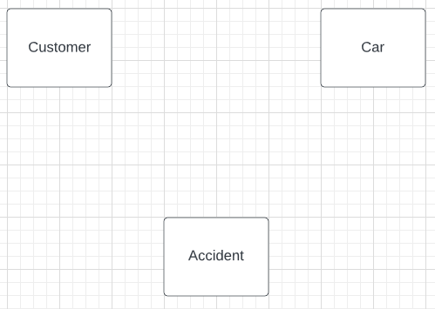
Case Study

Slide 7
Case Study
Our entities each have attributes
Customers:
memberID, name, email, phoneNumber
Cars:
carID, make, model, year
Accidents:
claimID, location, date, damageTotal

Slide 8
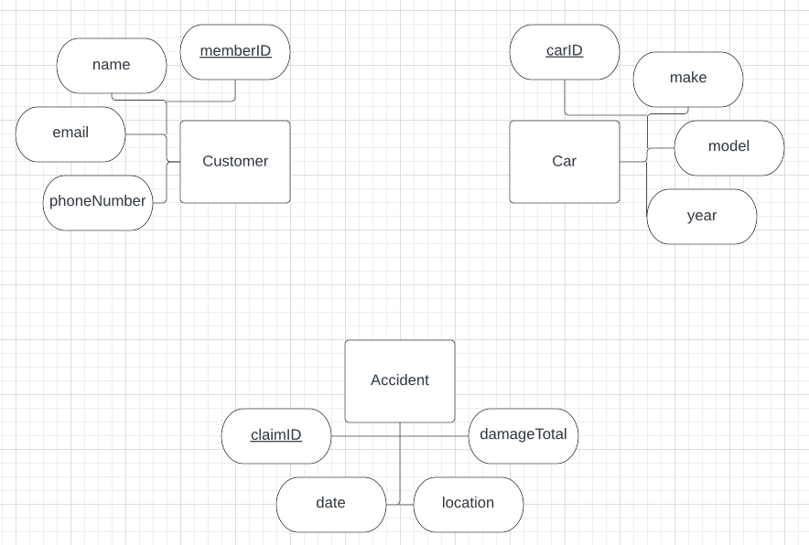
Case Study

Slide 9
Case Study
Our entities each have relationships
A customer can have one or more car
A car can have zero or more accidents

Slide 10
Case Study
Our entities each have relationships
A customer can have one or more car:
For each customer, there can be many cars
For each car, there can only be one customer
The relationship between customer and car is one to many
(Note, the opposite relationship between car and customer is many-to-one. This describes the same type of relationship, you just always start with the entity you are describing first.)

Slide 11
Case Study
Our entities each have relationships
A car can have zero or more accidents:
For each car there can be many accidents
For each accident, the insurance claim is for one car
The relationship between cars and accidents is one to many

Slide 12
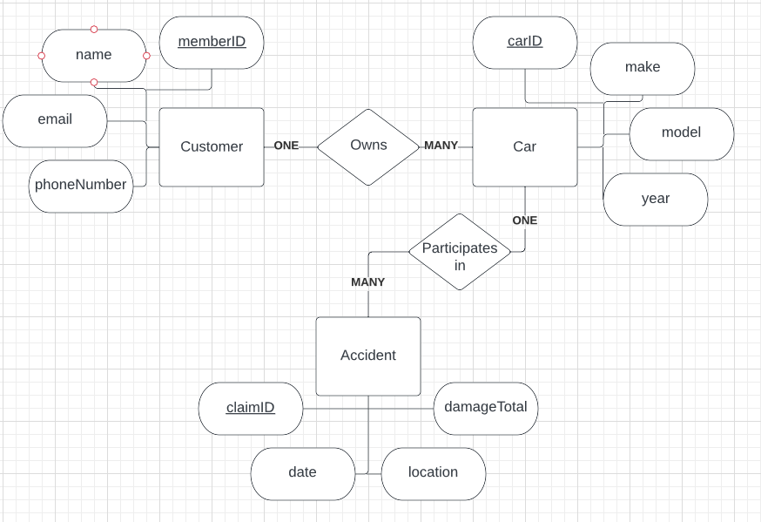
Case Study

Slide 13
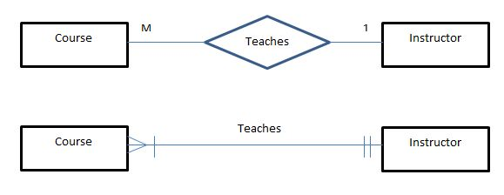
A Note on Relationships
In ER Model examples you find online, you will sometimes see shorthand for “One” and “Many” that look like the below. A “One” is represented by two parallel lines, and a “Many” is represented by an arrow and a line. Both are valid notation for relationships on the ER Model, feel free to use either when creating your charts.

